Slide 1


Bluffs & Bribes Pitch
By Isabel Hampton

Slide 2


Concept
Texas Hold’em style poker rogue-like
Players compete to survive as many hands as possible, max out their chips and eliminate opponents
A twist on the traditional game of bluff, with even more lies as everyone is cheating, including the dealer…

Slide 3
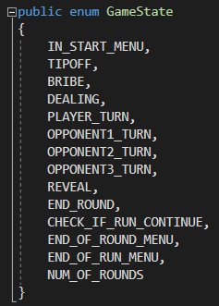
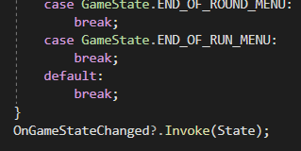
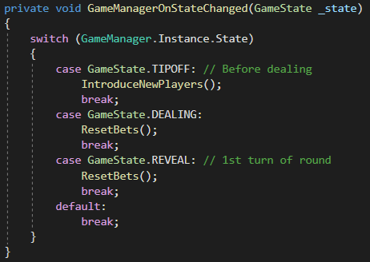
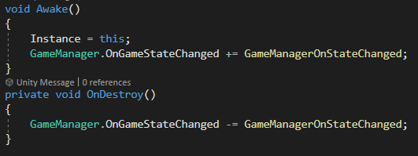
Mechanics – Core Gameplay
Turns are controlled by a Game Manager’s state property and events being called when this changes
Figure 2: End of GameManager’s UpdateState() method invoking event on other objects
Figure 1: Enum of states
Figure 3: Example of BetManager listening for change in state
Figure 4: Example of object subscribed to event

Slide 4
Mechanics – Tip Offs
At the start of some rounds, the player may receive tip off notes from other players
These notes help the player work out when/ how much they should bribe in each round
However, as you more play more runs you’ll learn not everyone slipping you advice can be trusted
Players can view their unlocked tip offs at any time in the tip off menu

Slide 5
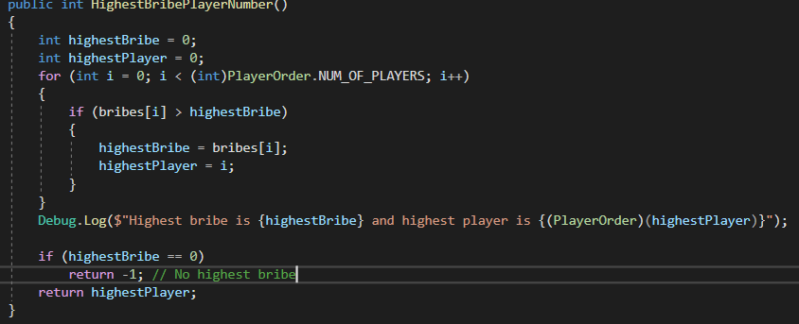
Mechanics – Bribery
At the start of each round everyone has the option to bribe the dealer
Based off the tipoffs that the player has received, they must learn how to successfully bribe the dealer to get the best hands, and avoid being thrown out for cheating
The highest bribe will receive a rigged hand in the next deal
Figure 5: Method for checking highest bribe player – called before dealing

Slide 6
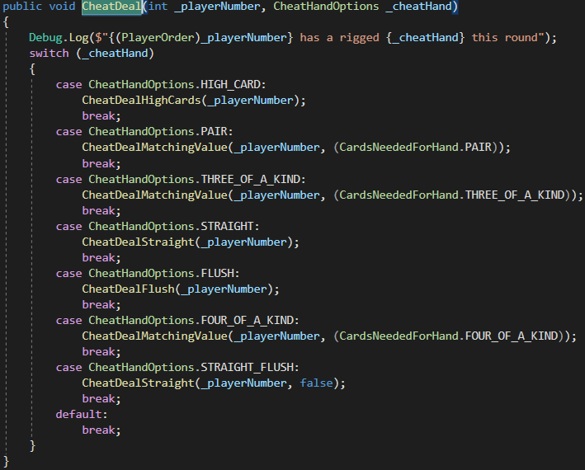
Mechanics – Dealing
After bribing stage, the HandManager will check if any players bribed and if so, the highest bribe will receive a rigged hand
Plans to improve how the type of rigged hand is selected, as this is currently random
Figure 6: Method for cheat dealing player a random hand

Slide 7
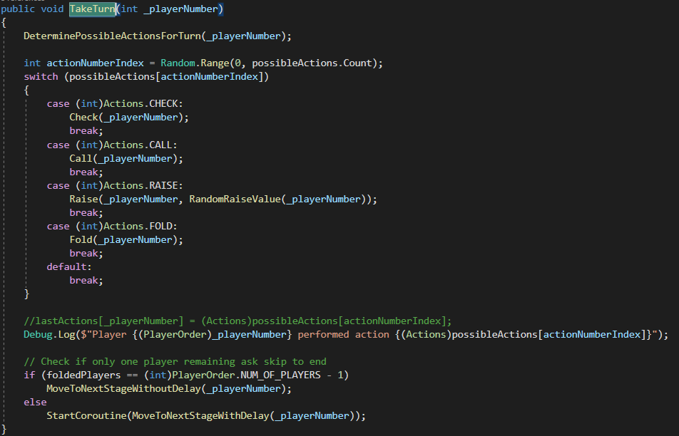
Mechanics – Turns
On the player’s turn, the UI will give them their possible options to Check, Call, Raise or Fold
Opponents will check what bets are currently outstanding for this turn and determine whether they are able to Call, Check, Raise or Fold and pick a valid action
Plans to improve the opponent AI to select actions more strategically, as currently the choice is random out of all valid actions available
Figure 7: Method for enemies taking turn

Slide 8
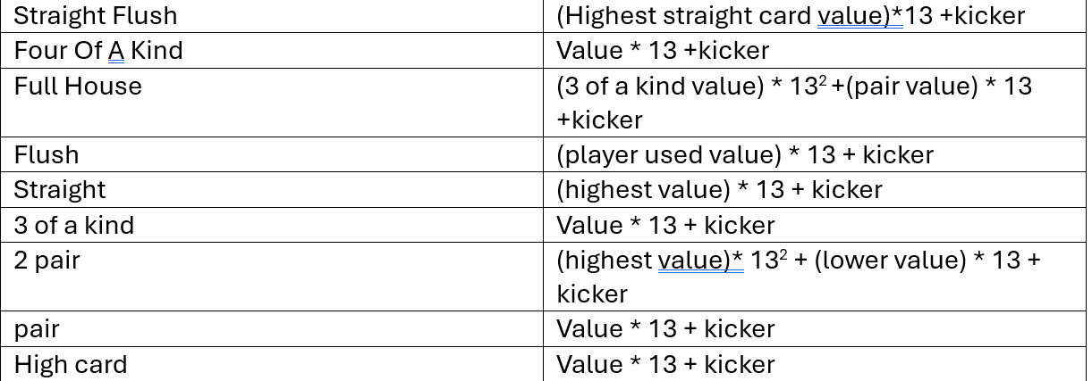
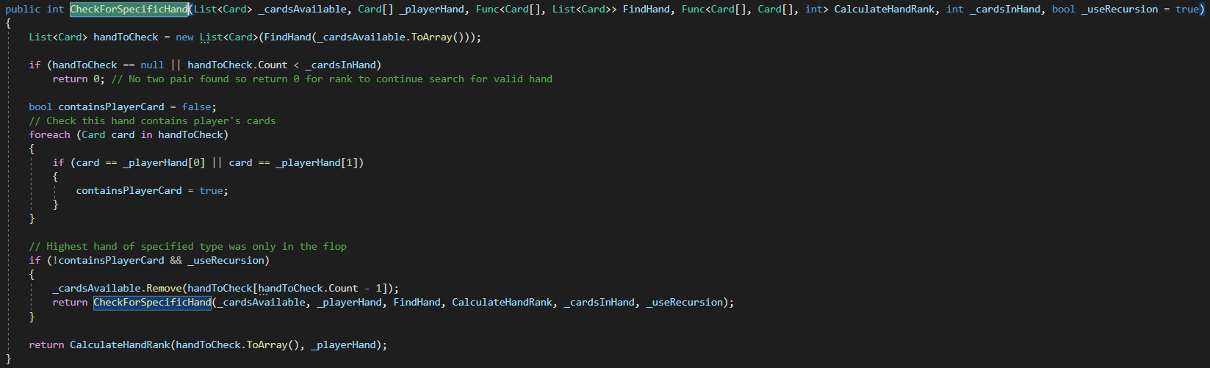
Mechanics – Reveal
Once all turns have been taken, the hands are revealed and the winner receives the pot
Hands are ranked following traditional rules accounting for the kicker card
Figure 8: Rank calculation for each hand type
Figure 9: Generic method for recursively finding hand type and returning rank

Slide 9
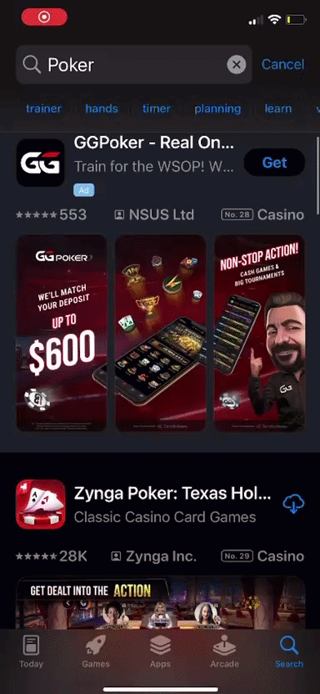
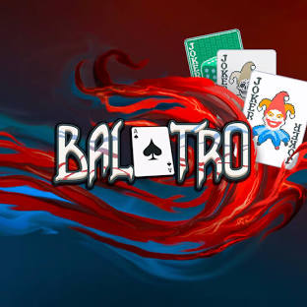
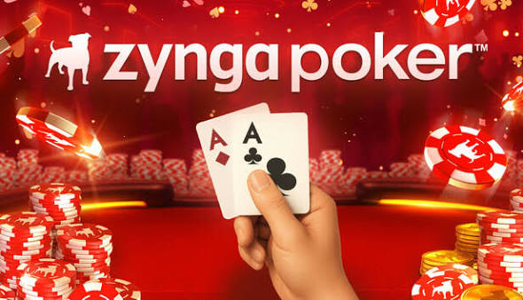
Market Research
Texas Hold’em is the most common poker style for mobile games – so will be familiar to the widest range of players
2 successful similarly themed games are:
Figure 10: Balatro
^{12nd} in Top Paid Card Category on App Store
6th in Card Category on Google Play, with 1M+ downloads’
Figure 11: Zynga Poker
2nd in Casino Card Category on App Store
50M+ downloads on Play Store
Figure 12: Screen recording of App Store results for “poker”

Slide 10



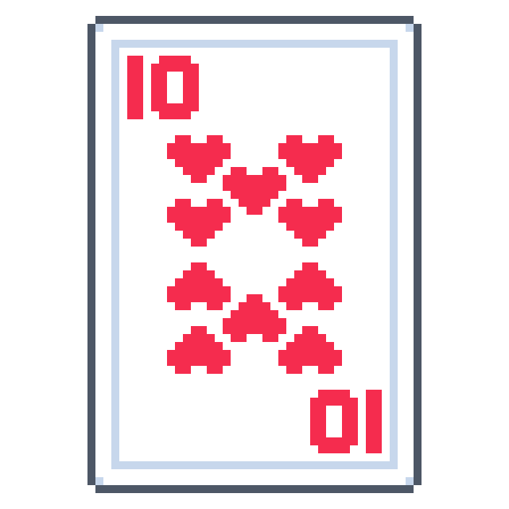
Robust UI
Locked into landscape
Tested on all devices in Unity Simulator and scales correctly
In process of implementing a script to confine Canvas to phone’s safe area as for some resolutions in Simulator it spills over

Slide 11
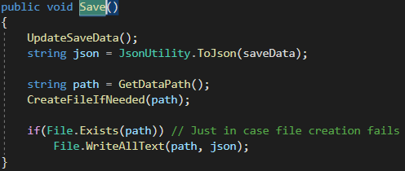
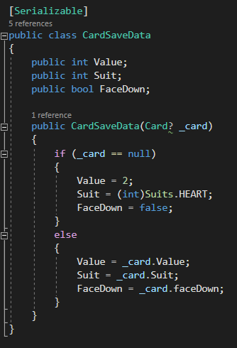
Data Persistence
On app losing focus, the game will save the current state, and all data needed to restart the same run once the app reopens
Cards need a special SaveData class as not all properties in the Card MonoBehaviour need saving
Figure 13: Save method called OnApplicationPause
Figure 14: CardSaveData class

Slide 12
Mobile Features

Slide 13

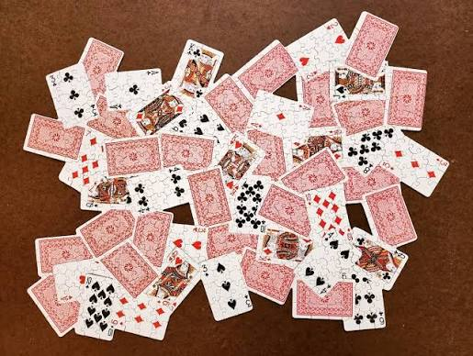
Camera & AR
Vibrations
Accelerometer/ Gyroscope
Using CandyCoded Haptic Feedback package
Implements light, medium and heavy feedback on different button presses/ situations
Implemented both for shake detection – accelerometer works best
Used for menu on shake will visually jumble cards
Players will have AR mode option to play game with cards projected on real table
Start of prototype currently implemented with horizontal plane detection
Figure 15: Concept for menu

Slide 14
Frameworks

Slide 15
Unity Ads
Leaderboards
In-App Purchases
Option to watch an ad when out of chips to keep the run going
Pop-up ads between runs
Banner ads on menu screen
Option to remove ads from game
Can purchase in-game currency to continue game if out of chips
Separated into 3 categories:
  Max chips throughout run
  Max rounds completed
  Max enemies eliminated

Slide 16
Unity Analytics
AR
FMOD
Gain a better understanding of player behaviour to help improve features
Collect performance data to find areas for optimisation
For better control and implementation of music and sound effects within the game
Explore existing AR packages for mobile support to improve on current prototype

Slide 17
Accessibility

Slide 18
Accessible Actions
Customisable UI
Simplified Inputs
Option to switch to more accessible font
Scalable text/buttons
Colour contrast
All actions have option to be completed with tap
Motion controls can be skipped
Gamepad supported (recommended by Special Effect)
No actions in game will be reliant on sound/colour
All actions will always have an option for players with limited motion
Text-to-speech to read out button purposes/cards

Slide 19
Cross Platform
Not reliant on device’s OS
Scales well on wide range of iPhone and Android devices
Setting up AR with iOS and Android packages
Built and tested on Android and planning to test soon on iOS
Added controller support would allow this game to be easily ported onto other devices

Slide 20
Next Steps

Slide 21
Features
Bug Fixes
Improvements
Chance for duplicate cards being dealt when rigged 4 of a kind in play
Prevent player from raising when all opponents are already all in
Players should have a minimum bet to play round
Add option to change UI from simplified, power saving and fully interactive
Finish font switching for accessibility
Opponents act more strategically
AR Mode
Accessibility Features
Tutorials & pause menus
Unity Ads
Unity Leaderboards
In-app Purchases

Slide 22
Thank you for listening!
Any questions?

